Slide 1
Linear Block Copolymers
Date:19/02/2019
Measurement:Static
Batch: Linear BCPs 2019_02_07

Slide 2
Static information
Using Ocean Optics stage point
Ref and Dark file: topsilminusopticsLBCP
Refractive index:
Polystyrene 632.8nm 1.58654
Polyisoprene 632.8nm 1.52
PMMA 589.3nm 1.4905

Slide 3
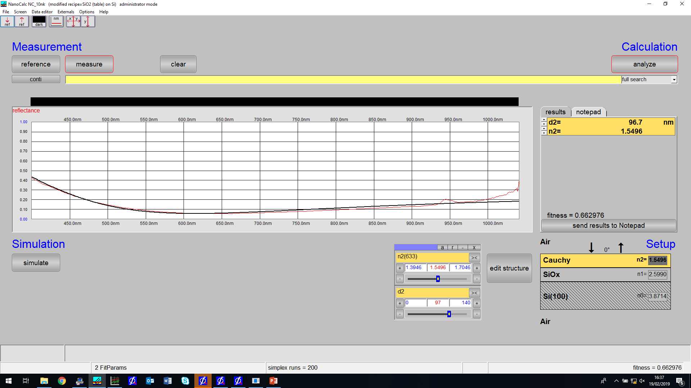
PISIO 3pct 3k id:370 ref:topsilminusopticsLBCP

Slide 4
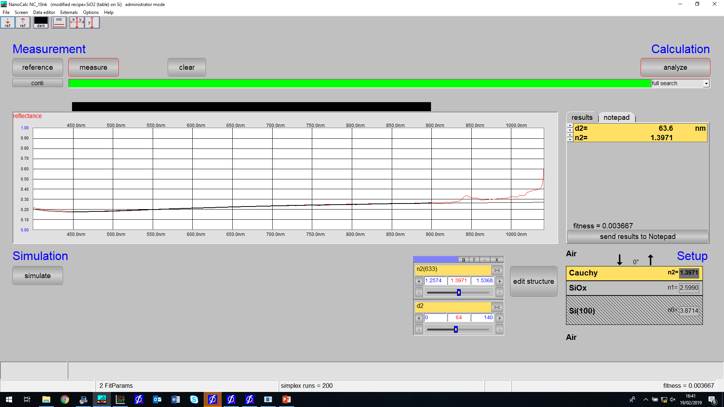
PISIO 2pct 6k id:373 ref:topsilminusopticsLBCP

Slide 5
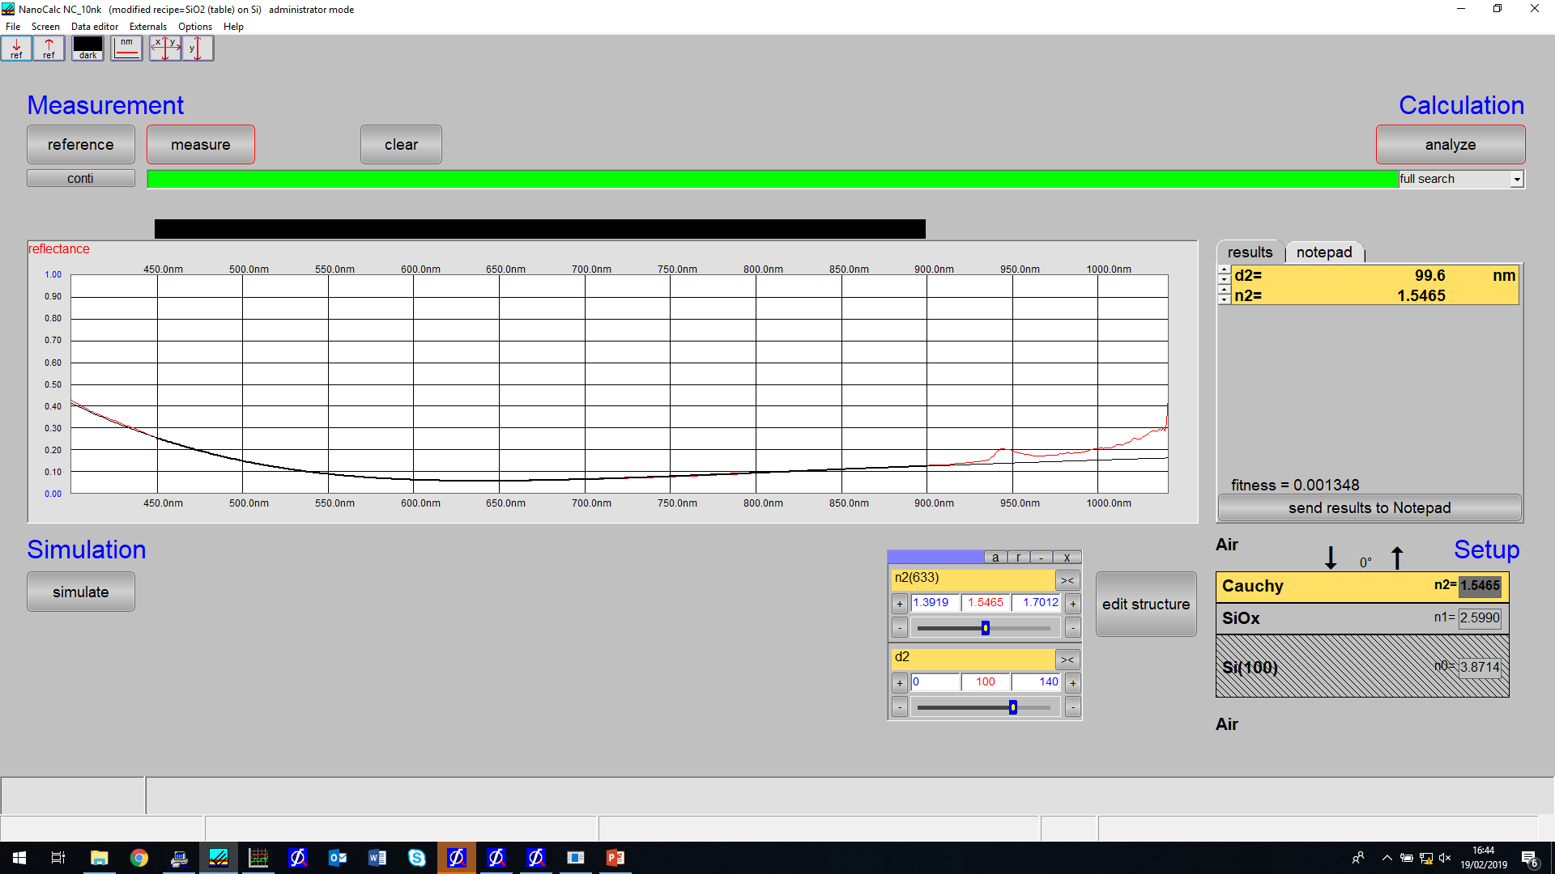
PISIO 3pct 3k id:370 ref:topsilminusopticsLBCP - redo

Slide 6

PISIO 2pct 6k id:378 ref:topsilminusopticsLBCP

Slide 7

PISIO 3pct 3k id:366 ref:topsilminusopticsLBCP

